Slide 1

Top-Down vs Bottom-Up Design
Common pitfall: start with the details first

Slide 2
Top-Down vs Bottom-Up Design
Better solution: Figure out how all the components fit together first, then build them

Slide 3
What is an API?
Application Programming Interface
Sits between layers or components in a system
Defines a contract for how the components will behave
Anything that an external component relies on is part of the API

Slide 4
API Example
Cars have an API:
Use the steering wheel to steer, the gas to go, the brake to stop
Users don't need to know the details:
Drive-by-wire vs mechanical linkages
Different types of brake disks
How an internal combustion engine works

Slide 5
Why APIs?
Allows interacting with a component without knowing the details of how it works
Important for scaling software:
Each piece is complicated, no one can keep track of all details at once
APIs let you focus on just one piece at a time
Any separation between components has an implicit API, but not necessarily a good one (organic APIs are usually bad)

Slide 6
Why APIs?
Side benefit: Promotes better design
Highly-coupled components tend to be fragile
APIs push design to a top-down approach, which produces more flexible and simpler coding than bottom-up design

Slide 7
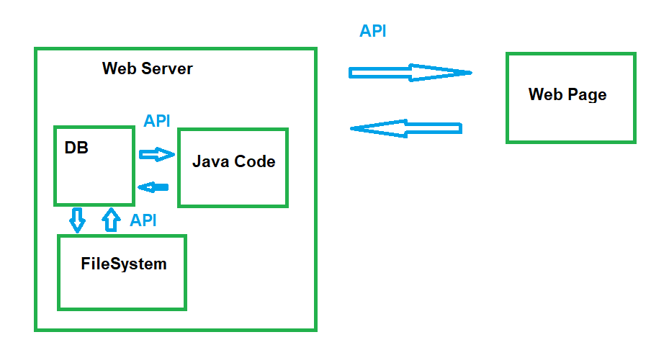
Component APIs
Any boundary between components needs an API
network boundaries
process boundaries
conceptual boundaries

Slide 8
System Design Diagram
Used to identify where APIs are needed
Helpful first step before architecting a large system
Useful for parallelizing work across many people/teams
Acts like an informal UML
Not a Flowchart

Slide 9
Systems Design Diagrams
Start with an overall workflow for the system
Initial Layout: For each step, assign it to a component - draw a box and label it
Environmental Features: Surround any components that live on either the same physical server or in the same process with an extra box
Interactions: Each time a component interacts with another, draw an arrow to connect them - these will be the APIs
Simplify: Sometimes two components will be the request/response steps for a single user action; identify these and combine them into a single component. Similarly, if any components are the only component within a server/process boundary, you can remove the double-box around them.
Note: a component from 'outside' a box should only interact with the outermost layer, which in turn will interact with internal components; this separates external and internal APIs to simplify backwards-compatibility guarantees

Slide 10
Systems Design Diagrams
When have you simplified enough?
- Whenever possible, have pairs of arrows between components representing request/response pairs
A system with a single arrow is unusual and more complicated:
A single arrow means there is no response to indicate that a task is completed, successful, or failed
Any such system also needs components to monitor and potentially redo the task in question

Slide 11
Systems Design Diagrams - Removing Single Arrows
Protocols with no response (SMTP): "resend this email"
No way to remove the single arrow, just build a way to re-send
Tasks with delayed response:
Add some sort of id/lookup key response
Add another component to "check status" using the key
ex: placing an order on a website returns an order number, which allows someone to look up the status of the order over several days

Slide 12
Systems Diagrams Example
Example: Adding a 'Search' feature to an application
Overall workflow:
A user will enter terms in the search bar and hit enter. That request will go to a server that will create a parsed version of the query, then compare that against indexed data. The results will be compiled into a user-friendly format and then returned to the application.

Slide 13
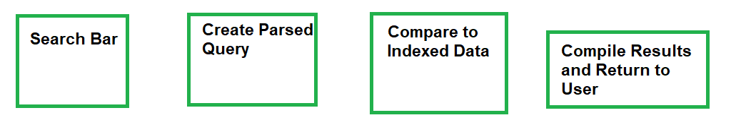
Systems Diagrams Example
Overall workflow:
A user will enter terms in the search bar and hit enter. That request will go to a server that will create a parsed version of the query, then compare that against indexed data. The results will be compiled into a user-friendly format and then returned to the application.
Step 1: Create a component for each step

Slide 14
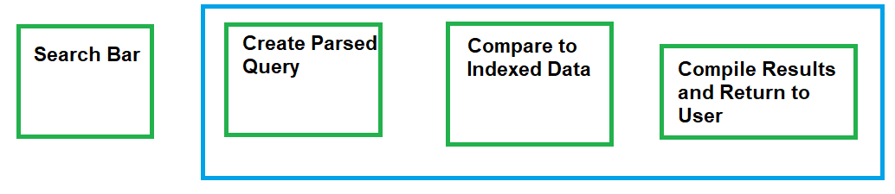
Systems Diagrams Example
Step 2: Add server/process boundary boxes

Slide 15
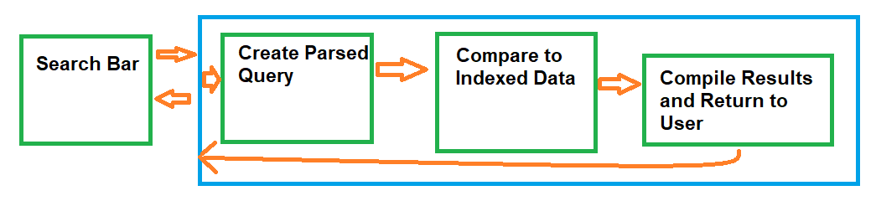
Systems Diagrams Example
Step 3: Draw component interactions

Slide 16
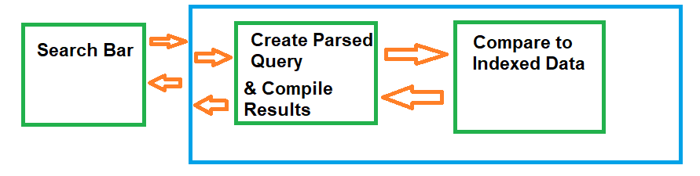
Systems Diagrams Example
Step 4: Combine request/response components & remove extra boxes

Slide 17
Systems Diagrams Example
Now we can read the required APIs off the diagram:
one network API from the search bar to the network-facing server (needs wire compatibility)
one internal/in-process API from the networking layer to the query-parsing/translation component
one internal/in-process API from the parsing component to the indexed data searching component.

Slide 18
Your turn!
Create a systems diagram for the following workflow:
A user will enter data in a website form and submit it. That information will get sent to the server, which will transform it into a SQL query and send that to a database. The database results will get transformed back into javascript-friendly results, and returned to the website to be displayed.
Run through the four steps to create the systems diagram:
Initial Layout: For each step, assign it to a component - draw a box and label it
Environmental Features: Surround any components that live on either the same physical server or in the same process with an extra box
Interactions: Each time a component interacts with another, draw an arrow to connect them - these will be the APIs
Simplify: Sometimes two components will be the request/response steps for a single user action; identify these and combine them into a single component. Similarly, if any components are the only component within a server/process boundary, you can remove the double-box around them.

Slide 19
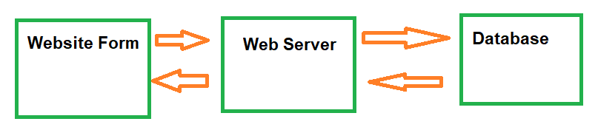
Web Form Systems Diagram
A user will enter data in a website form and submit it. That information will get sent to the server, which will transform it into a SQL query and send that to a database. The database results will get transformed back into javascript-friendly results, and returned to the website to be displayed.

Slide 20
Web Form Systems Diagram (Alt)
What's different here?
Why would you choose one vs the other?

Slide 21
Designing the API
The API is the layer between components, and acts as a contract between them
Each component has a copy of the contract, but "the API" isn't a single piece of code

Slide 22
Designing a Good API
APIs should be designed from the perspective of the user, not the implementer
Avoids a "leaky abstraction", where details of how a component works end up in the API
Captures behavior, not data (although the line can be blurry)
Needs enough power to be useful, but also an easy learning curve
Make the common things easy, and the weird things possible
Remember: you can always add things to an API, but it's difficult to remove or change things
Initially, aim for a Minimum Viable Product (MVP) approach - what's the smallest set of things that will let a user accomplish what they need to

Slide 23
Backwards Compatibility
For widely used, public, open source projects (Ex: protocol buffers, the JRE):
Many clients
No complete list of all clients, much less access to their code
⇒ Breaking changes are a Big Deal, and very rare
Ever wondered why generics are wonky in Java? To maintain 1.4/1.5 compatibility

Slide 24
Backwards Compatibility
Some APIs have a narrower scope: within a company, team, or project
Backwards compatibility is still important!
Consider a simple web server: a client process and a server process
When upgrading, one option is to turn everything off, upgrade everything, and then turn it back on
Ex: "Caution: AmateurHour.com will be going down for maintenance from 3am to 6am on Friday"

Slide 25
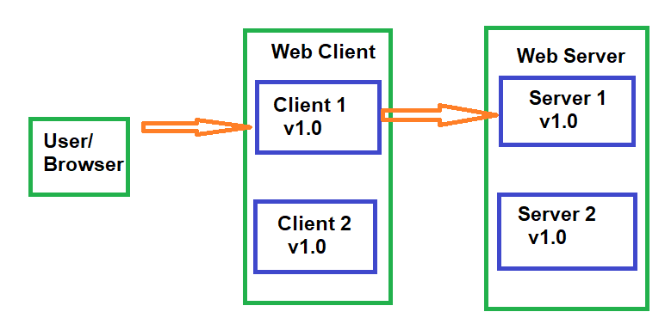
Online Updates
Better option: At least 2 copies of every process with network failover.
Ex: a user is connected to Client 1, which starts off connected to Server 1; both clients/servers are running identical software

Slide 26
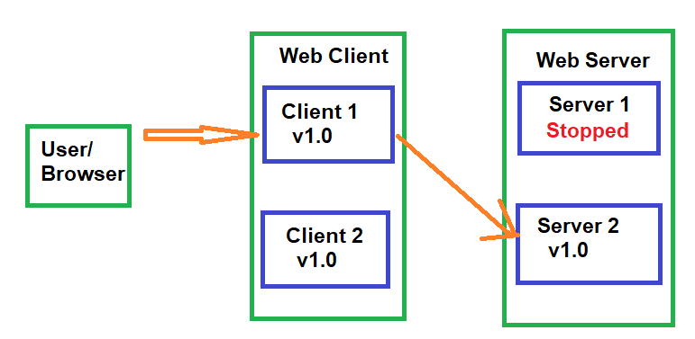
Online Updates
To update to v1.1: first stop the Server 1 process. Client 1 will fail over to Server 2; this will at worst cause a browser-refresh style hiccup for a user, but typically it's not noticeable

Slide 27
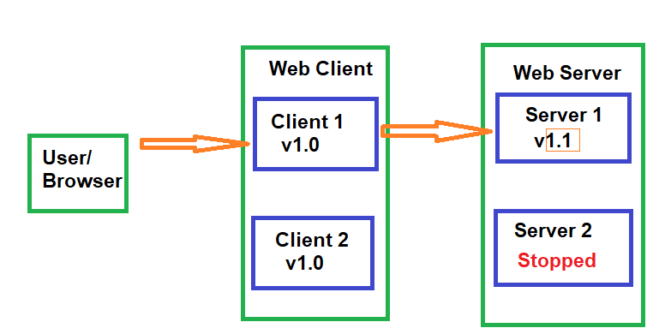
Online Updates
Now, update the binaries on the server, start Server 1 back up, and do the same for Server 2

Slide 28
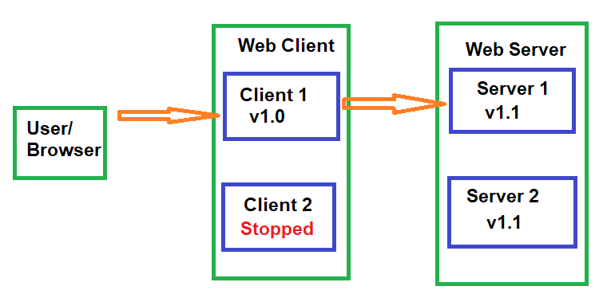
Online Updates
Once the servers are updated, the clients can get sequentially updated as well. All of this relies on a client running v1.0 still being able to talk to a server with v1.1, which means the API must be backwards compatible for at least one version

Slide 29
Online Updates
In practice, this whole process is often automated, with Server 1 having to pass some automated health checks before Server 2 gets upgraded, as part of a continuous deployment pipeline

Slide 30
Types of Backwards Compatibility
APIs are contract between different components, which may change and upgrade at different rates, with different people
It's important to maintain backwards compatibility with an API
What type of backward compatibility is actually part of the API:
Source compatibility: code written with a previous version still compiles
Wire compatibility: an application built against a previous version can still talk to a new server
Semantic compatibility: an application's behavior doesn't change

Slide 31
Examples of Breaking Changes
Source compatibility: code written with a previous version still compiles
Previous API:
public Set<Object> createCollection();
Breaking Change:
public Collection<Object> createCollection();
Non-breaking Change: returning a HashSet instead of a TreeSet
⇒ Make your return types as general as possible

Slide 32
Examples of Breaking Changes
Wire compatibility: an application built against a previous version can still talk to a new server
Previous API:
Using default Java serialization:
public Widget createWidget();
Breaking Change:
Create a new class that implements Widget and return it; Java serialization will fail on the application side
Non-breaking Change:
Use an explicitly backwards/forwards compatible wire format such as JSON or protocol buffers
⇒ Make serialization and persistence explicit parts of the API

Slide 33
Design For Change - Versioning
Any time something is serialized or persisted it should have a version number
Default for java Serializable is serialVersionUID
Two major properties:
The version number should an incrementing sequence
Version should be automatically set given the compiled version of the code: ex: protocolBufferBuilder.setVersion(VERSION);

Slide 34
Examples of Breaking Changes
Semantic compatibility: an application's behavior doesn't change
Previous API:
public float parseString(String number) throws NumberFormatException;
Breaking Change:
/* Returns Float.NaN if the number doesn't parse */
public float parseString(String number);
⇒ Build in error handling from the beginning
Non-breaking Change:
@deprecated /** Prefer parseStringNoThrow */
public default float parseString(String number) throws NumberFormatException {
float result = parseStringNoThrow(number);
if (result == Float.NaN) {
throw new NumberFormatException();
}
}
/* Returns Float.NaN if the number doesn't parse */
public float parseStringNoThrow(String number);

Slide 35
Number of Versions of Compatibility
Large open-source projects will typically support APIs for many years
Breaking changes are indicated by incrementing the major version number
Internal-only or smaller projects may have shorter support windows
Most common is one minor release
Version numbers: major.minor.hotfix/patch (ex: Java 1.6.u45)
Generally, deprecate functionality for one support window, then remove it

Slide 36
API Design Feels Backwards
Up until now: I want to build a thing → I go build the thing
New and improved: I want to build a thing → I go do something else entirely, and then eventually come back to building the thing
Seems counterintuitive, but trust the process! Somewhere around the middle of the semester, suddenly all that "something else entirely" will really start to pay off

Slide 37

API Design Feels Backwards
Initial API Design steps don't seem to be getting anywhere
Think of it like an image loading over time - the first few steps are really blurry, but they're still important

Slide 38
API Example: Building a Server For a Website
After building the System Design Diagram, focus on each API between components
Ex:
A user (via their browser) will connect to a web server for a social media site. Initially, we just want the user to be able to view their profile and make changes to it.

Slide 39
API Example: Building a Server For a Website
Step 1: Identify the client
In this case, the website frontend
Note that the client isn't always a person, or the end user - the client of an API is the person or (usually) program that will be interacting with it directly

Slide 40
Your Turn! (Part 1 of Many)
After seeing how each piece works with our social media site example, you’ll implement the same part of the process with a different system
Goal: You've been asked to build a key-value store system, where another program can store and retrieve arbitrary bytes of data.
Step 1: Who is the client for this system?

Slide 41
Part 1 Solution
Goal: You've been asked to build a key-value store system, where clients can store and retrieve arbitrary bytes of data.
The client will likely be another piece of code:
web server
another backend server
probably not an actual person
⇒ The user can be trusted (mostly)
⇒ The user (for a given system) is likely unique - no need to manage different profiles

Slide 42
API Example: Building a Server For a Website
Step 2: List out what the user needs to be able to do.
In our case, that might be:
Log in to the site
Load a profile
Make changes to a profile

Slide 43
Your Turn! (Part 2)
Goal: You've been asked to build a key-value store system, where clients can store and retrieve arbitrary bytes of data.
The client will be another piece of code (some sort of server)
Step 2: List out what operations the client will need to perform

Slide 44
Step 2 Solution
Goal: You've been asked to build a key-value store system, where clients can store and retrieve arbitrary bytes of data.
The functionality it needs to support:
Store bytes of data
Later, look up the corresponding data

Slide 45
Writing the Actual API
Step 3: Build a prototype
To go from a high-level approach to the actual code, build a prototype use case.
This isn't an actual website, or anything that will ever be used; it's to iron out the details to make sure the API is both well-specified and sufficiently powerful
Where the actual website will have forms for input, responses to user actions, etc, the prototype just focuses on the interactions with the API
Start with the high-level approach as comments, and fill it out as you go

Slide 46
Writing the Actual API (Next Checkpoint)
Prototypes are frequently JUnit Tests, but we won't cover testing until next class.
For now, the prototype for SomeApi will have the format:
PrototypeSomeApi.java:
public class PrototypeSomeApi {
public void prototype(SomeApi server) {
// prototype goes here
}
}
This code isn't accessible from any code entry points (no main method or @Test annotation), so it will never run, that's ok
Prototype code just needs to compile

Slide 47
Prototype the Use Case
First, just add comments
public void prototype(WebServer server) {
// log in the user
// load their profile
// make a change to the profile
// reload the updated version of the profile
}
This step will often flag functionality that was missed during the initial brainstorming, such as a 'log out' option

Slide 48
Prototype the Use Case
First, just add comments
public void prototype(WebServer server) {
// log in the user
// load their profile
// make a change to the profile
// reload the updated version of the profile
// logout
}
All fixed!

Slide 49
Making Code Compile
The previous slide created a new type (WebServer)
As you're writing the code, you want it to compile - when you have a referenced type that you haven't implemented yet, create it as an empty interface:
WebServer.java:
public interface WebServer {
// nothing here yet!
}
⇒ Your IDE can help you with this! Try hovering over the red squiggle, and use the option to create a new type

Slide 50
Your Turn! (Part 3)
Goal: You've been asked to build a key-value store system, where clients can store and retrieve arbitrary bytes of data.
The client is another piece of code/other server
The functionality it needs to support:
Store bytes of data
Later, look up the corresponding data
Create a PrototypeDataStore.java with the comments + methods version of the API
Hint: This should compile, so you may need to create an empty interface

Slide 51
Part 3 Solution
public void prototype(DataStore dataStore) {
// store some data
// retrieve the data
}
DataStore.java:
public interface DataStore {
// nothing here yet
}

Slide 52
Prototype the Use Case
Step 4: Fill out the template
public void prototype(WebServer server) {
// log in the user: what do we need to build a LoginRequest?
LoginResponse response = server.login(new LoginRequest());
// load their profile
// make a change to the profile
// reload the updated version of the profile
// log out
}
Often, filling in the first few lines doesn't seem like it's actually clarifying anything, but you'll notice we now have two concrete interfaces and a method. Remember, this first pass is still fairly high-level and vague; leave further needed details as comments

Slide 53
API Design Best Practice: Always Have a Return Value
LoginResponse login(LoginRequest loginRequest);
Why not void?
Return values allow you to:
Handle error cases more gracefully
Propagate exceptions across network/process boundaries
Add functionality later without breaking backwards compatibility

Slide 54
Prototype the Use Case
public void testWebServer(WebServer server) {
// log in the user: what do we need to build a LoginRequest?
LoginResponse loginResponse = server.login(new LoginRequest());
// load their profile
if (loginResponse.success()) {
ProfileLoadResponse profileLoadResponse = server.loadProfile(loginResponse.getUserIdentifier());
}
// make a change to the profile
// reload the updated version of the profile
// log out
}
As we fill out the next few lines, we'll start to implicitly fill out some of the interfaces; we need to know if the login worked, and in order to load a profile we need a user id, which we would have to get from the login info (good thing we had a response!)

Slide 55
API Design Best Practice: Wrapper Interfaces
ProfileLoadResponse loadProfile(UserIdentifier user);
Why not 'String username' or 'long userId'?
Exactly!
How the system wants to implement a unique id per user is an implementation detail
Leaving it unspecified allows for a flexible implementation, or multiple/changing implementations

Slide 56
Prototype the Use Case
public void testWebServer(WebServer server) {
// log in the user: what do we need to build a LoginRequest?
LoginResponse loginResponse = server.login(new LoginRequest());
// load their profile
if (loginResponse.success()) {
ProfileLoadResponse profileLoadResponse = server.loadProfile(loginResponse.getUserIdentifier());
// make a change to the profile: what do we need to create one of these
ProfileChangeRequest changeRequest = new ProfileChangeRequest();
ProfileChangeResponse profileChangeResponse = server.updateProfile(loginResponse.getUserIdentifier(), changeRequest);
// reload the updated version of the profile
profileLoadResponse = server.loadProfile(loginResponse.getUserIdentifier());
// log out
server.logout(loginResponse.getUserIdentifier());
}
}

Slide 57
API Design Best Practice: Many Object Interfaces
ProfileChangeResponse changeProfile(UserIdentifier user, ProfileChangeRequest request);
Shouldn't we be reusing code and combining some of these response values?
Nope!
Copy-pasting logic is bad, that's something you encapsulate and re-use
Reusing methods is also a good idea
On the other hand, allow wrapper interfaces to proliferate wildly
Leaving these separate allows for future flexibility
reuse is great for situations where you control all uses of the code, but APIs are the opposite
tldr: Types = don't reuse, Methods = do reuse

Slide 58
Writing the actual API: Method Signatures
public interface WebServer {
LoginResponse login(LoginRequest loginRequest);
ProfileLoadResponse loadProfile(UserIdentifier user);
ProfileChangeResponse changeProfile(UserIdentifier user, ProfileChangeRequest request);
LogoutResponse logout(UserIdentifier user);
}

Slide 59
Your Turn!
Recall from earlier:
public void prototype(DataStore dataStore) {
// store some data
// retrieve the data
}
DataStore.java:
public interface DataStore {
// nothing here yet
}
Now, fill out each commented line, generating interfaces/methods in DataStore as necessary to make everything compile

Slide 60
Prototyped Data Storage Layer
public void prototype(DataStore dataStore) {
// store some data
DataStorageResponse storeResponse = dataStore.storeData(new DataStorageRequest());
// retrieve the data
DataLoadResponse loadResponse = dataStore.loadData(storeResponse.getDataKey());
}

Slide 61
Prototyped Data Storage Layer
public interface DataStore {
DataStorageResponse storeData(DataStorageRequest request);
DataLoadResponse loadData(DataStorageKey key);
}

Slide 62
Prototyped Data Storage Layer
public interface DataStorageRequest {
// TBD
}
public interface DataStorageResponse {
DataStorageKey getDataKey();
}
public interface DataStorageKey {
// TBD
}
public interface DataLoadResponse {
// TBD
}

Slide 63
Writing the actual API: Filling in the Rest
public interface LoginResponse {
boolean success(); // Oh no! Booleans are bad
UserIdentifier getUserIdentifier();
}
public interface UserIdentifier {
// marker interface
}

Slide 64
API Design Best Practice: Booleans are Bad (Usually)
Problem 1: Very inflexible (only ever has two values)
What happens if we want to add details about why the login failed?
Problem 2: Not self-documenting
ex: server.loadProfile(true, false, true, true, false, "");
The fix: Enums

Slide 65
Enums (Enumerations)
Alternative to listing out a bunch of constants
Use ==, not .equals()
Should only be used for known-at-compile-time, immutable state

Slide 66
Updated API
public interface LoginResponse {
LoginResponseCode getResponseCode();
UserIdentifier getUserIdentifier();
}
public enum LoginResponseCode {
SUCCESS,
FAILURE;
}

Slide 67
Updated Prototype
public void testWebServer(WebServer server) {
LoginResponse loginResponse = server.login(new LoginRequest());
// load their profile
if (loginResponse.getResponseCode() == LoginResponseCode.SUCCESS) {
// etc
}
Better for flexibility, but we've sacrificed some usability

Slide 68
Encapsulated Booleans
public enum LoginResponseCode {
SUCCESS(true),
FAILURE(false);
private boolean success;
private LoginResponseCode(boolean success) {
this.success = success;
}
public boolean success() {
return success;
}
}
Adding a layer of indirection gives us flexibility plus usability

Slide 69
More Updated Prototype
public void testWebServer(WebServer server) {
LoginResponse loginResponse = server.login(new LoginRequest());
// load their profile
if (loginResponse.getResponseCode().success()) {
// etc
}
That looks better! The 'easy thing' (see if a login happened) is still easy, but now more complicated things (details of the login success/failure) are possible

Slide 70
Encapsulated Booleans
public enum LoginResponseCode {
SUCCESS(true),
FAILURE(false),
UNKNOWN_USERNAME(false);
private boolean success;
private LoginResponseCode(boolean success) {
this.success = success;
}
public boolean success() {
return success;
}
}
We can add more detailed failure modes in a backwards-compatible way

Slide 71
Default Values
"Make the common case easy"
Wherever possible, provide default values in the API (usually configuration settings)
Built-in example use case
Low cost to start using the API
Note that changing a default is a semantic break; use commonly-useful defaults rather than sentinel values
Ex: the number of threads to use for an execution. Depending on the program, you might use:
1 ⇒ Multi-threading is an advanced option not generally needed
4 ⇒ Given how the code is written, more threads will tend to get stuck waiting on locks
Runtime.getRuntime().availableProcessors() ⇒ Allows the program to self-tune by default
-1 ⇒ This would be a bad default value

Slide 72
Default Values
How to implement this?
For cross-network/cross-process APIs, typically done during deserialization
For in-process APIs, typically done by overloading a method:
public default int calculateValue(int input) {
return calculateValue(input, DEFAULT_NUM_THREADS);
}
public int calculateValue(int input, int nThreads);

Slide 73
Let's Review!
What you should know about API Design that might be on an exam:
Design principles for an API: What the design process is, what concerns to keep in mind, common pitfalls/best practices
Prototyping an API: What this looks like, why it's useful
Types of backwards compatibility: What they are, when to use them
Systems Diagrams: What they are, how to draw them, why to use them

Slide 74
Checkpoint 2: APIs for the Project
Github Issues:
Useful for tracking bugs, feature requests, and (for this assignment) tasks
Associate with a pull request
Optional, can be good practice with a bug queue
Lightweight, not integrated with github: Asana

